Slide 1
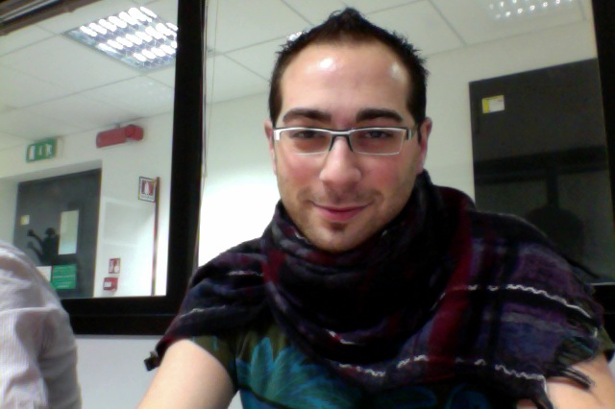



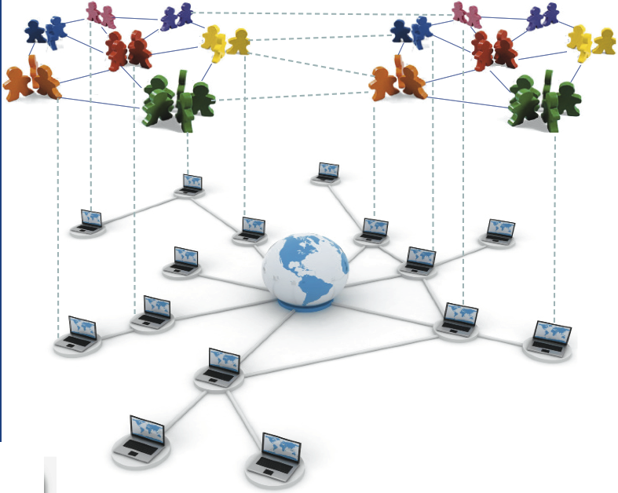
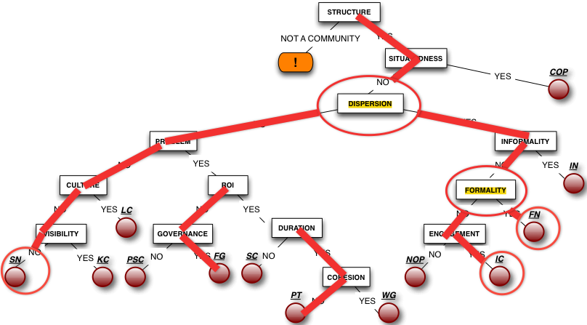
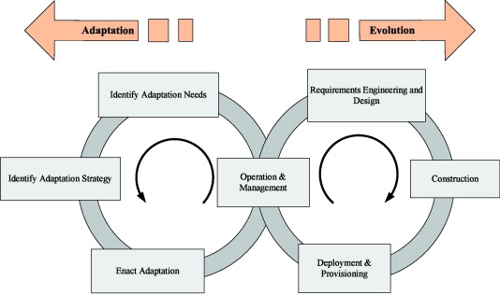
Service Networks for Development Communities
Damian A. Tamburri, Patricia Lago, Hans Van Vliet
VU University Amsterdam
Our Challenges
How can Service Networks Support Social Communities?
Can Dynamic Service-Discovery Support Evolving Communication?
Can we find Agility for Service Networks through Cloud Computing?
Service Networks entail people and services brought together by the internet
Our Current Work
A) Identify Communities’ Characteristics
B) Discover Service Networks
C) Adapt/Evolve Networks

